Slide 1


To talk to someone you know and find out his/her worries
To try to give some solutions to his or her problems
To learn to write about your friend’s problems in life and give your advice
To check yourself by doing some exercises

Slide 2


Translation.
1. 有许多担忧 ___________________
2. 与某人交谈 ___________________
3. 害怕做某事 ___________________
4. 最终 __________________
5. 生气 __________________
6. 犯一些粗心的错误 __________________________
have a lot of worries
talk to someone
be afraid to do sth.
in the end
be angry
make some careless mistakes

Slide 3
7. 分享我的问题 _______________________
8. 逃避问题 ___________________________
9. 将……分成两半 _____________________
10. 有时候他们在学业上出现问题。
_____________________________________________
share my problems
run away from the problems
cut … in half
Sometimes they have problems with their schoolwork.
11. 在生活中，有困难和担忧是正常的事。
_____________________________________________
12. 如果不和别人谈一 谈，我们肯定会觉得更糟。
_____________________________________________
Robert就一些寻常的问题向学生们提了建议。______________________________________________
Problems and worries are normal in life.
Unless we talk to someone, we’ll certainly feel worse.
Robert advises students about common problems.

Slide 4

Problems | Possible solutions
eat less junk food and more vegetables, do more exercise (锻炼)
too heavy
always be late for school
don’t stay up late, buy an alarm clock, ride a bike to go to school
Physics is difficult.
take notes in class, do more exercises (习题), ask the teacher for help
don’t have many friends
join a club,
play with your classmates

Slide 5

Unit 10

Slide 6
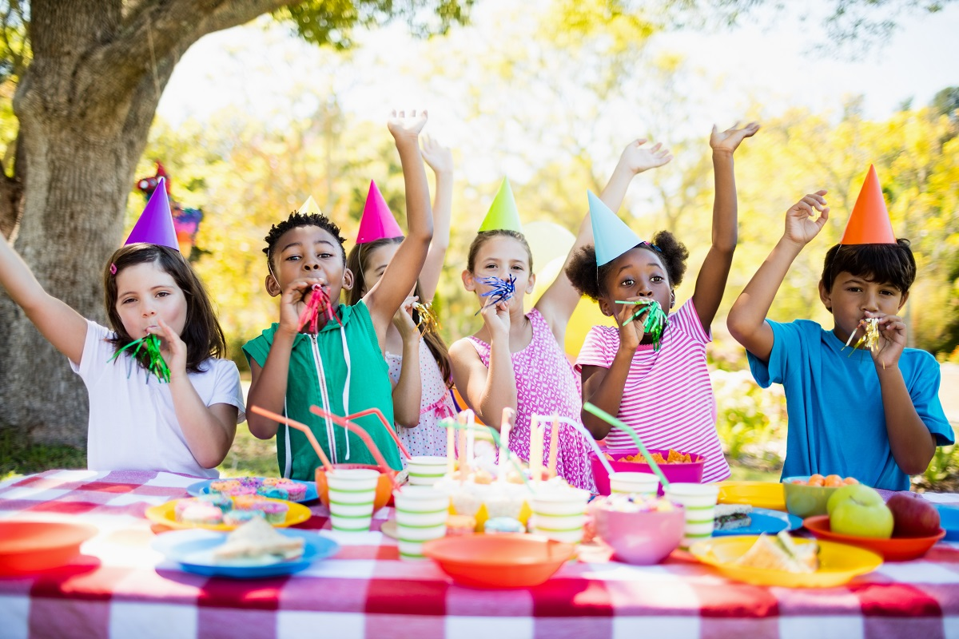
Unit 10
If you go to the party,
you’ll have a great time!

Slide 7



Slide 8


Slide 9



Talk with your partner.
Find out his/her three biggest worries/problems.
Try to think of some solutions to the problems and write them down.

Slide 10



Write about your friend’s first problem and the possible solutions.
Use the structures below to help you plan your writing.
Now write your advice for your friend’s second and third problems. Use the structures in 3b to help you.
who
1.My friend _______ has a problem.
2.He/She ____________________.
3.I think he/she should ________.
4.If he/she __________________, he/she will ________________.
worry/ problem
your ideas/suggestions
5.My friend also has two other problems._________
results

Slide 11

【审清题目】
内容：针对他人的烦恼提出建议；
首先，写清楚朋友的名字及现在存在的问题或困难。
然后，写出自己的建议。
用if从句来进一步说明自己建议将会起到的作用。
文体：说明文
时态：以一般现在时为主
人称：以第三人称为主

Slide 12
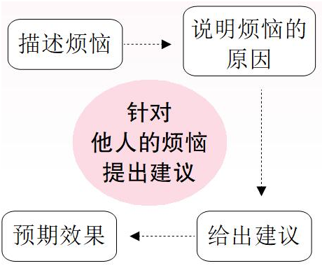
【头脑风暴】

Slide 13
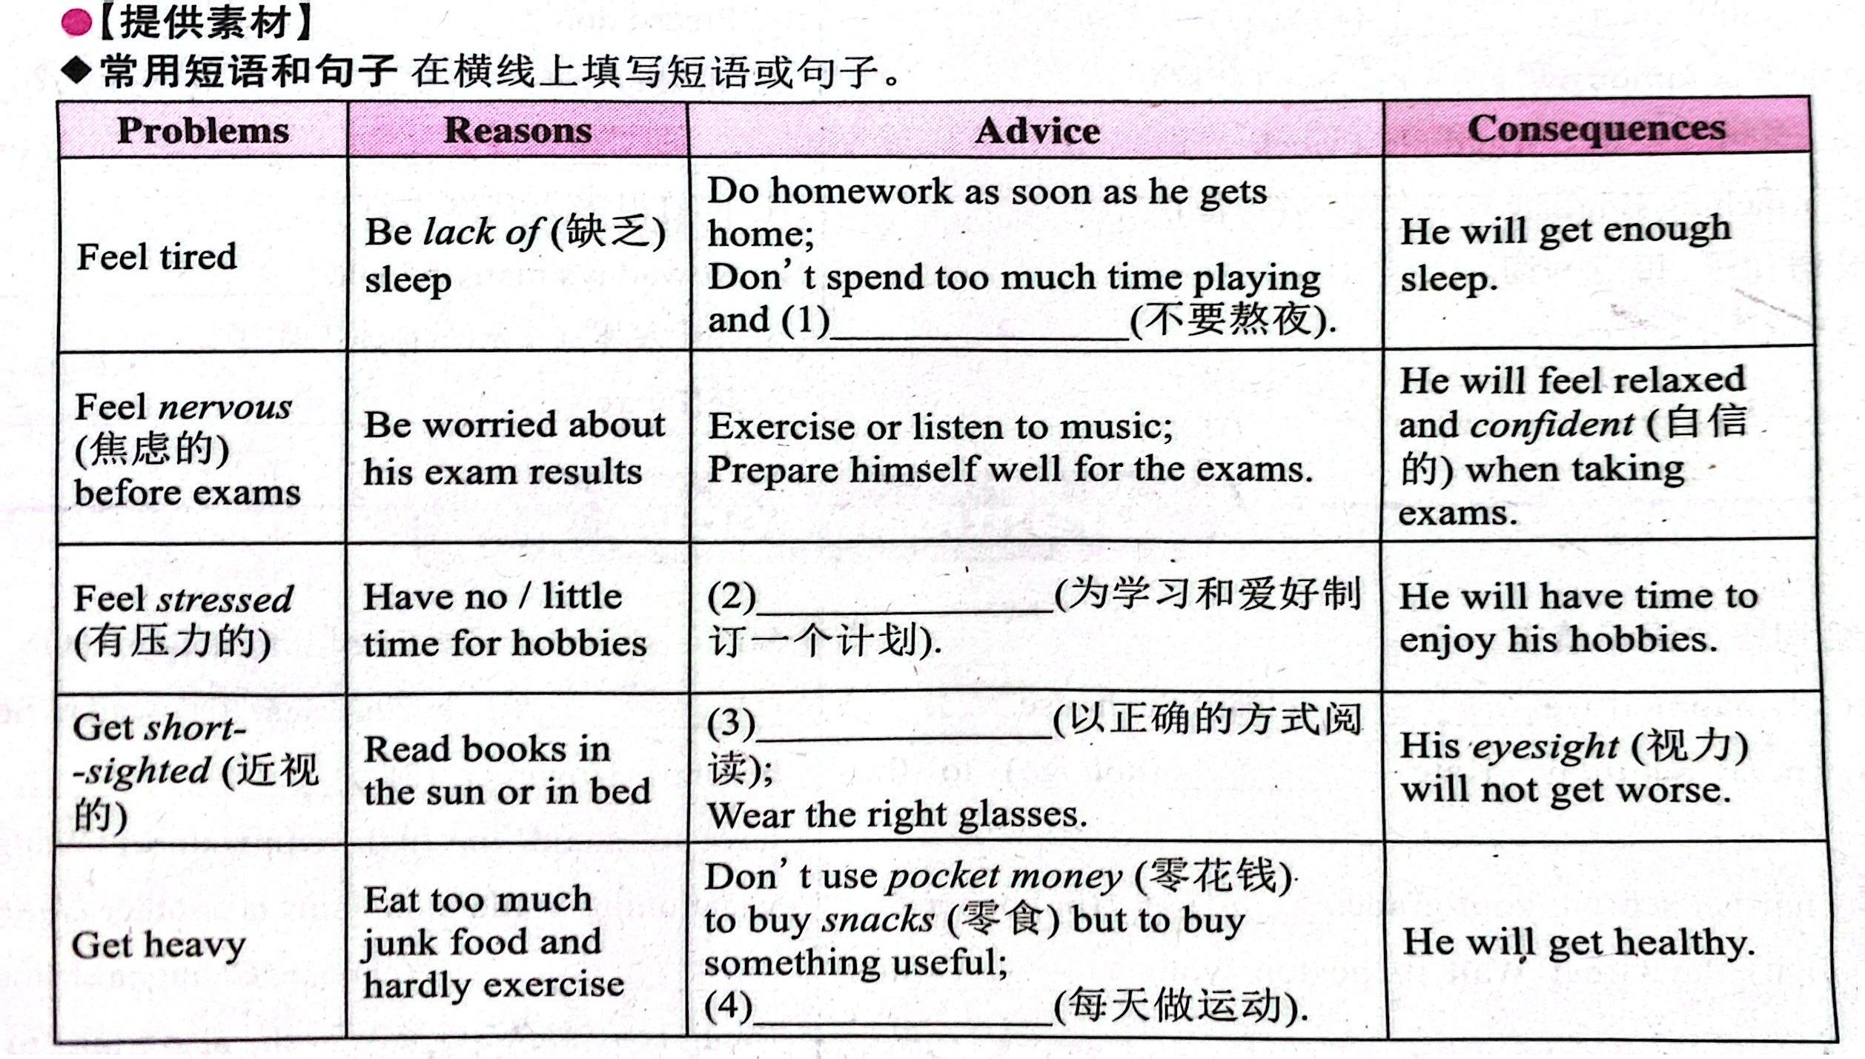
don’t stay up late
Read in the right way
the dark environment or close
Exercise every day

Slide 14
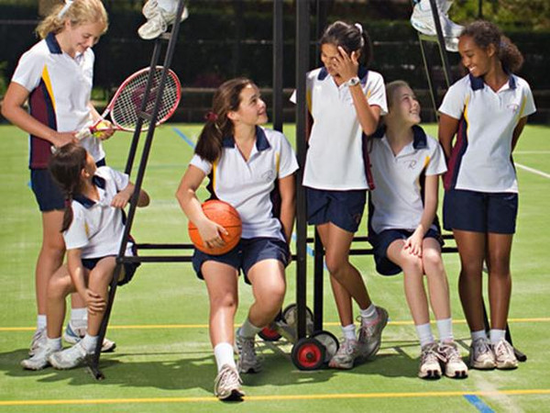
can’t sleep well/ feel tired
have no close friends to talk to
can’t get along well with classmates/parents
don’t have enough time to do sports/something intrested
can’t get good marks in tests
feel nervous before exams
get heavy

Slide 15
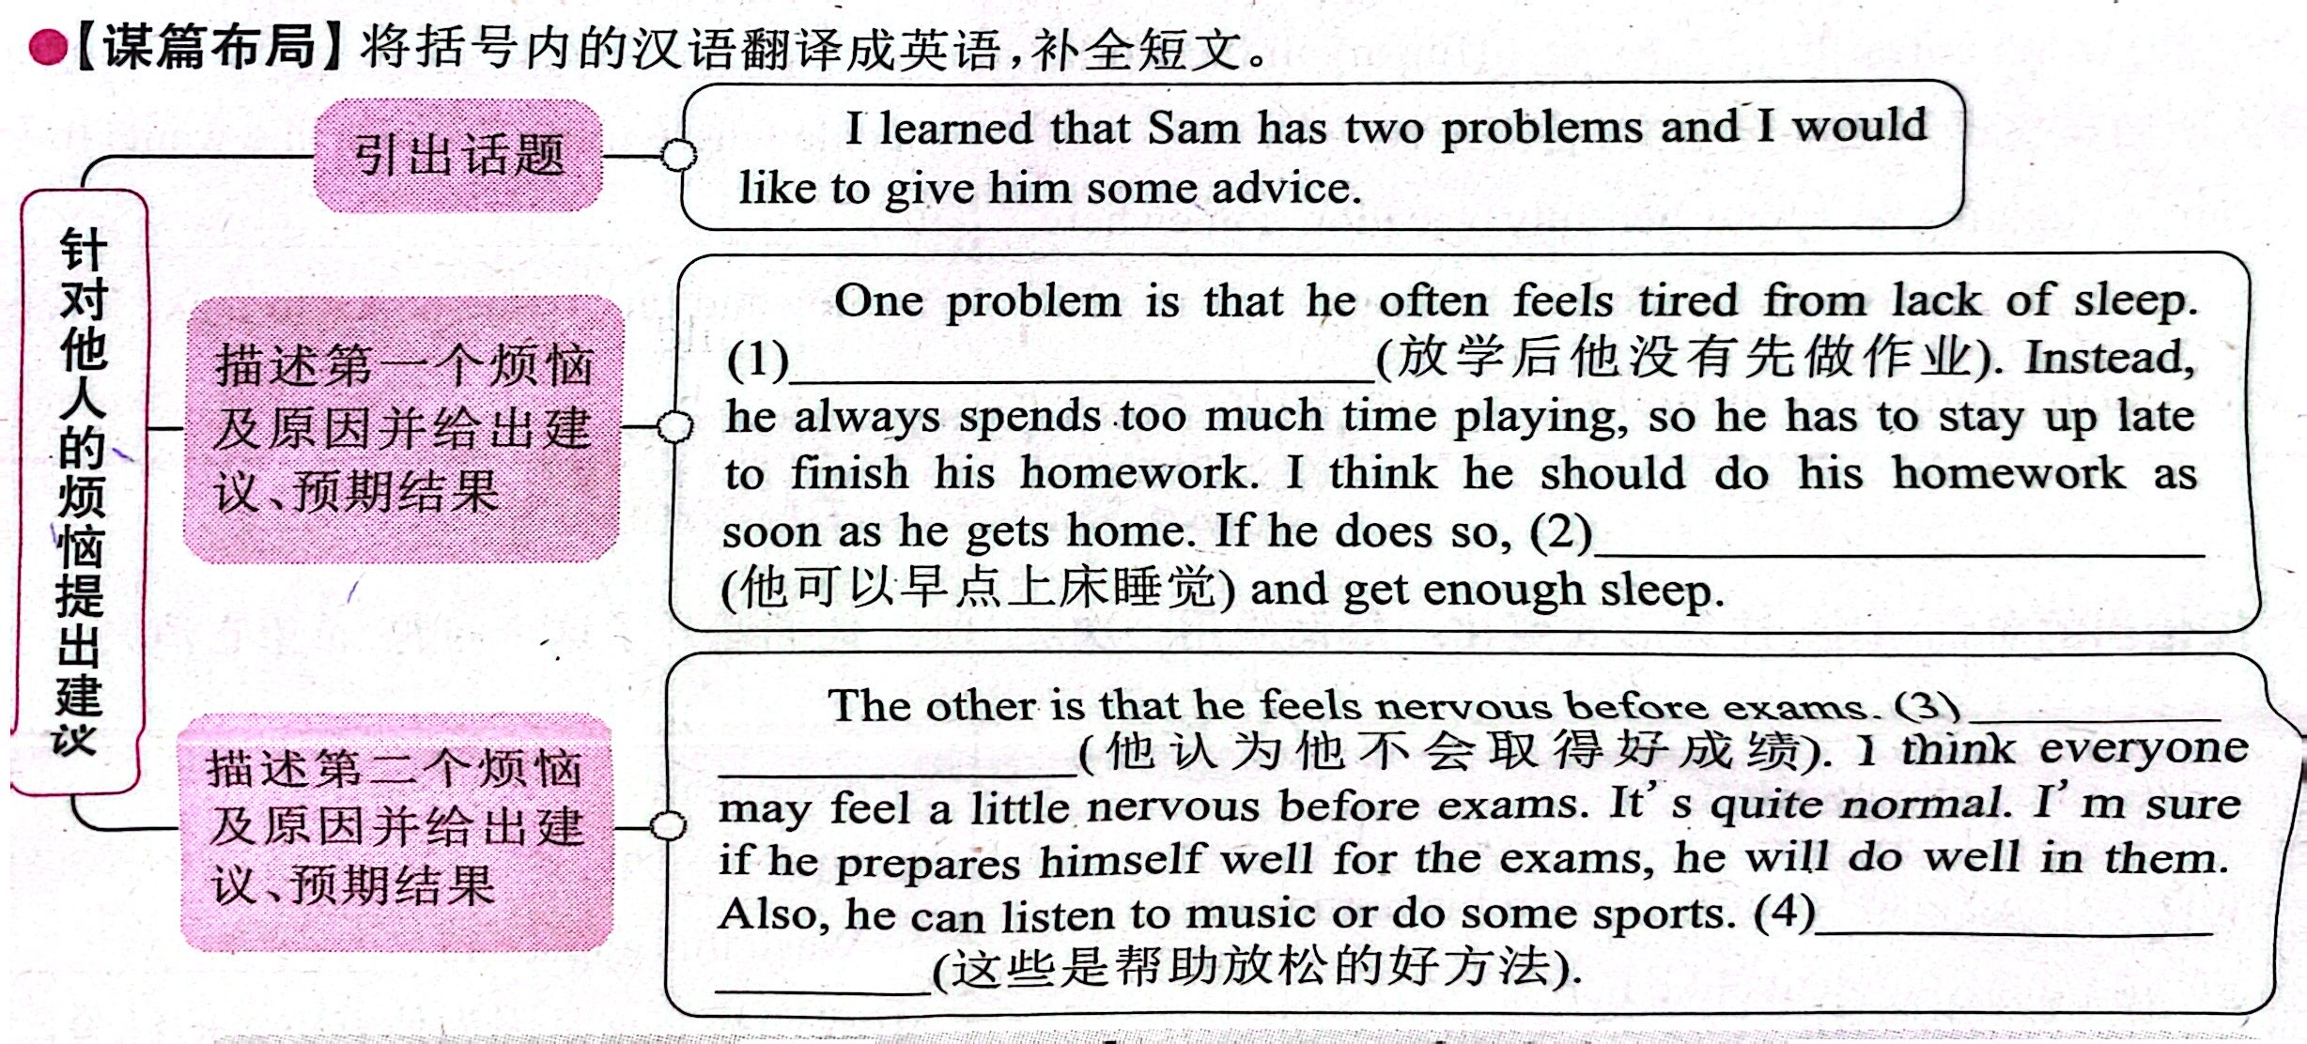

Slide 16


1. Fill in the blanks with the words in the box.
meeting, teenagers, video, experience
1. If my family travels to a new country this summer, I’ll send you a letter about my __________.
2. Will you watch the __________ with me if you’re free this weekend?
experience
video
3. If the _________ stay out too late, their parents will worry about them.
4. I’ll go to the _________ if it ends by 5:00 p.m.
teenagers
meeting

Slide 17
2. Complete the conversation with the words in the box. Some words are used more than once.
if, are, will, fight, want, sorry, going
A: Hi, Sally. ______ you _______ to the party tomorrow?
B: I _______ to, but I can’t.
A: Oh! But _______ you don’t go to the party, you _______ miss all the fun!
B: I know, but I got into a _______ with my parents.
Are
going
want
if
will
fight

Slide 18
if, are, will, fight, want, sorry, going
A: Hmm… then you should just say _______ to your parents.
B: I guess you’re right. I _______ talk to them tonight.
sorry
will

Slide 20
【提供素材】
◆短语&句子 根据汉语提示，写出对应的英文表达。
Problems | Reasons | Advice | Consequences
Feel tired | Be lack of (缺乏) sleep | Do homework as soon as he / she gets home; Don’t spend too much time playing and_____________ (不要熬夜). | He / She will get enough sleep.
don’t stay up late

Slide 21
Problems | Reasons | Advice | Consequences
Feel nervous (焦虑的) before exams | Be worried about his / her exam results | Exercise or listen to music; Prepare himself / herself well for the exams. | He / She will feel relaxed and confident (自信的) when taking exams.
Feel stressed (有压力的) | Have no / little time for hobbies | ________________ ________________ (为学习和爱好制定一个计划). | He / She will have time to enjoy his / her hobbies.
Make a plan for studies and hobbies

Slide 22
Problems | Reasons | Advice | Consequences
Get short-sighted (近视的) | Read books in the sun or in bed | __________________ (以正确的方式阅读); Wear the right glasses. | His / Her eyesight (视力) will not get worse.
Get heavy | Eat too much junk food and hardly exercise | Don’t use pocket money (零花钱) to buy snacks (零食) but to buy something useful; ____________ __________________ _____ (每天做运动). | He / She will get healthy.
Read in a right way
Do/Take exercise
/Do/ Play sports every day

Slide 23
◆句型
• I’d like to give ... some advice.
• I think he / she should ...
• If he / she ..., he / she will ...
• If he / she takes / follows my advice, he / she will ...
• Why not ...?
• He / She’d better ...
• It's better for him / her to ...

Slide 24

My friend Jenny has a problem. She has too much homework and she doesn’t know how to plan her time well. I think she should make a plan for doing her homework every day. If she can use some free time between classes and if she works on her homework as soon as she gets home, I think she will be able to deal with her heavy homework load.

Slide 25
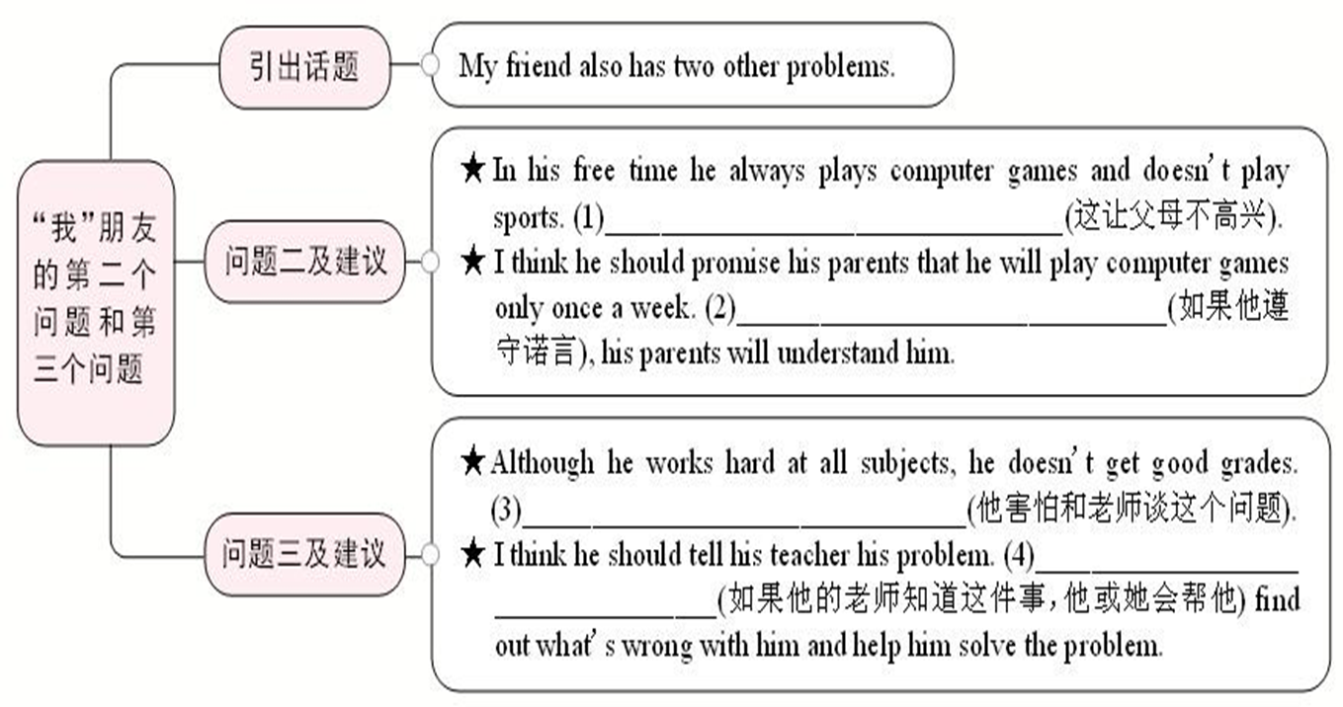
Now write your advice for your friend’s second and third problems. Use the structures in 3b to help you.

Slide 26

That makes his parents unhappy
If he keeps his promise
He is afraid to talk to his teacher about it
If his teacher knows
it, he or she will help him

Slide 27
【范文点评】
1) 陈述朋友的问题时可用the second one和the third one来罗列这两个问题，并体现这两个问题之间的顺序关系。
2) 问题二中的事情导致父母不高兴，在成文时，为避免重复，可用指示照应词that指代前一句话的内容，这样做不仅使前后句紧密连贯，而且使语言简洁。
3) 使用平行结构I think he should ... 及If ..., ... will ... 能使文章节奏匀称，使上下文成为有机统一体。

Slide 28
My friend also has two other problems.
The second one: In his free time he always plays computer games and doesn’t do sports. That makes his parents unhappy. I think he should promise his parents that he will play computer games only once a week. If he keeps his promise, his parents will understand him.

Slide 29
The third one: Although he works hard at all subjects, he doesn’t get good grades. He is afraid to talk to his teacher about it. I think he should tell his teacher his problem. If his teacher knows it, he or she will help him find out what’s wrong with him and help him solve the problem.

Slide 30


Your school is taking part in the project “We Can Help!” Add more items to the poster. Then talk about what you will do if you take part in the project.
We Can Help!
old people’s home visit
school clean-up
children’s hospital visit
_____________________
_____________________

Slide 31



What will you do if you visit an old people’s home?
If I do that, I’ll bring the old people some flowers.
If I do that, I’ll sing and dance for them to make them happy.

Slide 32
2. Complete the conversation with the words in the box. Some words are used more than once.
首先，应通读对话，了解大意。
其次，明确对话中A同学邀请的事由，以及B同学不能参加的原因及解决的办法。
然后，结合所给选项，逐句推敲选择。
空格后“to the party”，可知空格处应填go，时间状语tomorrow可知应用are going来表达将来时态。
if, are, will, fight, want, sorry, going
A: Hi, Sally. ______ you _______ to the party tomorrow?
B: I _______ to, but I can’t.
A: Oh! But _______ you don’t go to the party, you _______ miss all the fun!
B: I know, but I got into a _______ with my parents.
Are
going
want
下半句“但我不能”，可推断前半句意为“我想去”，故填want一词。
if
will
本句为含 if 条件状语从句的主从复合句，分析句意为“如果你不去，你将会错过所有的欢乐。”，故空格处填 if 与 will。
fight
句意“我知道，但是我与父母发生了争吵”，故填fight一词。

Slide 33
if, are, will, fight, want, sorry, going
A: Hmm… then you should just say _______ to your parents.
B: I guess you’re right. I _______ talk to them tonight.
sorry
will
say sorry to sb.向某人道歉，固定搭配，可知空格处应填sorry一词。
时间状语tonight，可知为一般将来时态，在谓语动词talk前，应用will一词来构成一般将来时态。

Slide 34
3. Use your imagination! What will you do if…
1. it rains all weekend?
If it rains all weekend, I’ll chat with my friends, read books and help with housework.
2. there’s an English test tomorrow?
If there’s an English test tomorrow, I’ll go over my books and notes.
3. your cousin decides to come and visit from another town?
If my cousin decides to come and visit from another town, I’ll have a party for him. And I’ll invite a lot of good friends.

Slide 35


go to college
travel around the world
make a lot of money
get an education
get advice from
keep ... to oneself
have problems with ...
be afraid to do sth.
in the end
make mistakes
worry about
run away from
try to do sth.
in half
be halfway to doing sth.
have a lot of experience

Slide 36


根据短文内容，从方框中选择恰当的单词填空，注意形式变化。
video, expert, make, experience, advise,
careful, solve, organize, careless, travel
Xin Xing is the world’s oldest panda living in captivity (圈养). She came to Chongqing Zoo in 1983 when she was one year old. In December 1988, she (1)___________ to Canada and was very popular with people there.
traveled/
travelled

Slide 37
video, expert, make, experience, advise,
careful, solve, organize, careless, travel
August 16 was Xin Xing’s birthday and more than one hundred panda fans (迷) (2)___________ a big birthday party for her at Chongqing Zoo. She came out of her panda house and enjoyed a cake (3)___________ of ice with fruit on it. A panda fan shot (拍摄) a short (4)___________ of the party and put it on the Internet.
organized
made
video

Slide 38
video, expert, make, experience, advise,
careful, solve, organize, careless, travel
Zhang Naicheng, the head of Chongqing Zoo’s panda house and also the zoo’s panda (5)___________, has looked after Xin Xing for 28 years. In 1992, Zhang Naicheng started to look after Xin Xing. He was always (6)___________ with his work, so he never made any (7)___________ mistakes. To look after Xin Xing well, he learned from other keepers (饲养员) with more (8)___________. He often asked them for (9)___________ when he met with problems.
expert
careful
careless
experience
advice

Slide 39
video, expert, make, experience, advise,
careful, solve, organize, careless, travel
Soon he became a good keeper and could (10)___________ most problems by himself.
“We have spent so much time together and she is like a family member to me,” said Zhang Naicheng. Now he still spends most of his nights staying in Xin Xing’s panda house.
solve

Slide 40


If your friend feels stressed because of having little time for his or her hobbies, what advice will you give? Write a short paragraph about his or her worry.

Slide 41


